Slide 1
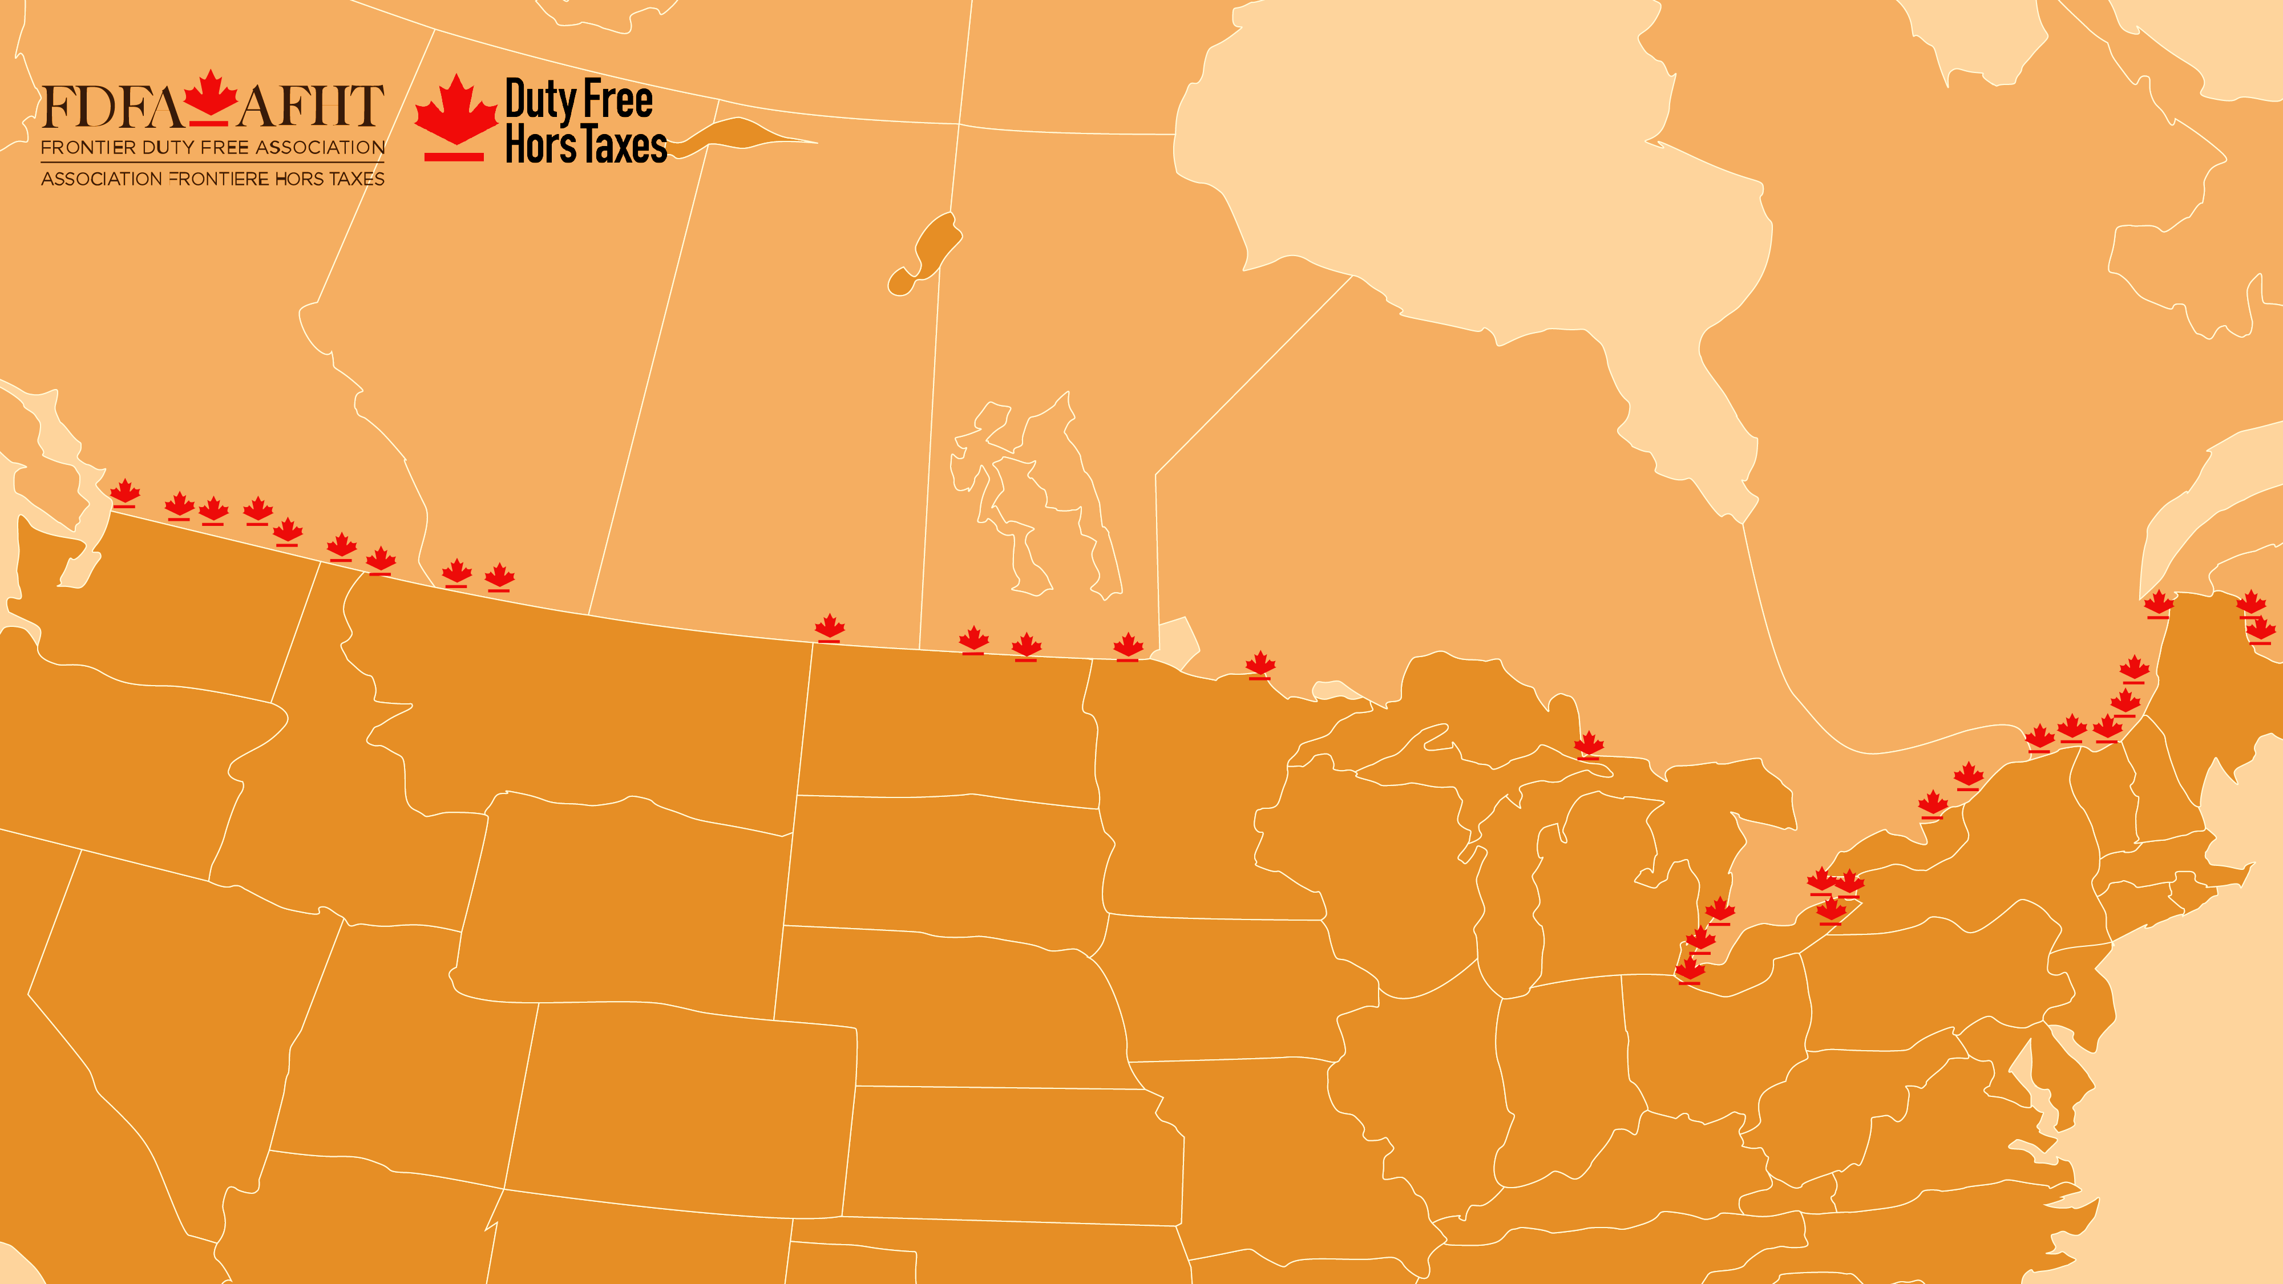


Canada’s Duty Free Shops
What suppliers should know
dutyfreecanada.com
fdfa.ca

Slide 2
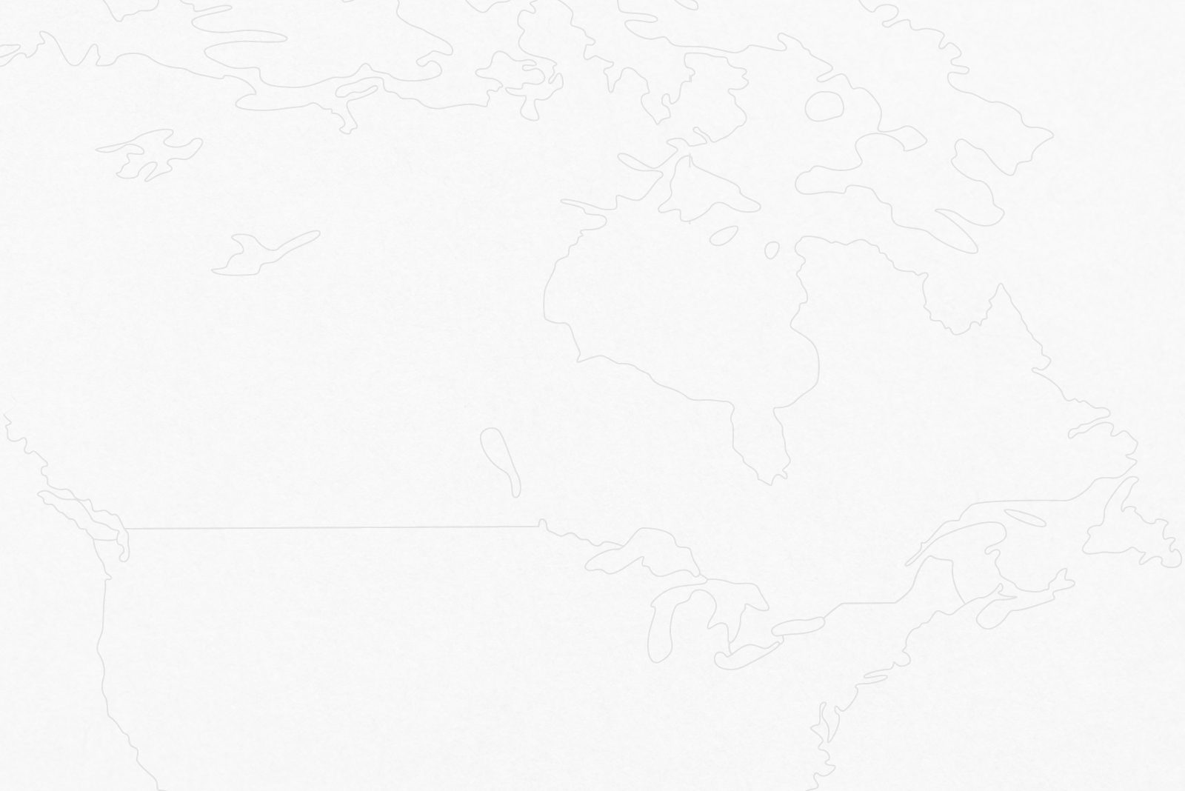


Canada’s Duty Free Shops
Canada’s duty free shops are unique retailers licensed by the federal government of Canada. There are currently 52 licensed shops, including 32 land border and 20 airport locations.
The first land border store opened in Canada in 1985. Land border shops are locally owned and operated private businesses, whereas many airport shops are owned by large international companies.
Duty Free Shops are licensed to sell goods free of certain Canadian duties and taxes normally applied, since all sales are deemed to be exports from Canada.

Slide 3
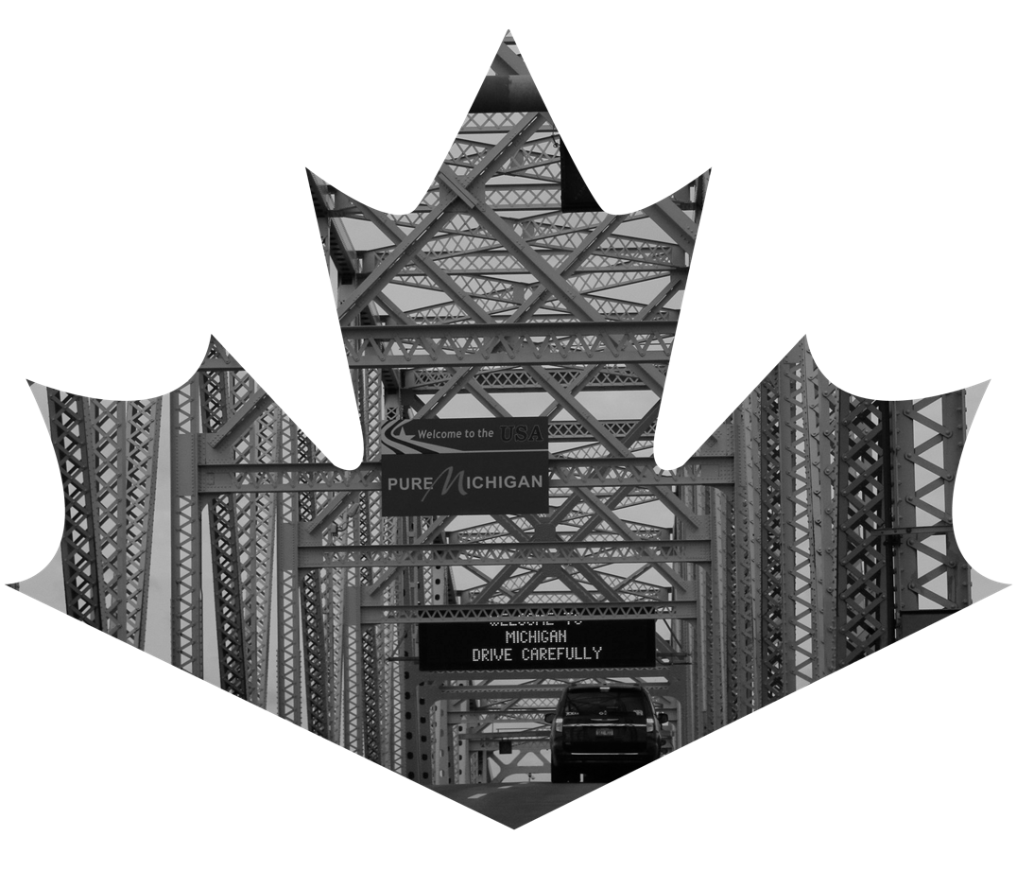
How they work
Land Border Duty Free Shops are located on secure sites at the border. They can only be accessed by travelers who will immediately leave Canada after making their purchase.
Information on duty free purchase limits (tax exemption) can be found online or in the shops.
  U.S. limits
  Canadian limits
The Canada Border Services Agency (CBSA) is responsible for licensing duty free shops in Canada and administering the laws, regulations and policies governing their operation. CBSA monitors duty-free shops to ensure they are compliant with government laws and regulations.

Slide 4
Product Purchasing
Each land border duty free shop individually selects and purchases the products to be sold in their store. Product offerings may vary from store to store, based on the unique features and customer demographics of the location.
Canadian land border duty free shops compete with U.S. duty free shops and retail stores on both sides of the border.
To be successful, the shops must purchase products at costs that enable them to offer substantive savings compared to U.S. duty free and retail prices. When selling to duty free shops, suppliers are provided with paperwork that exempts them from having to charge the taxes and duties. Goods can be shipped ‘in bond’, or suppliers can claim a drawback of taxes/duties paid if the goods have already been imported to Canada.
Liquor is purchased through provincial liquor boards. Liquor is normally sold in 1 litre bottles and labelling must comply with Canadian Food Inspection Agency (CFIA) requirements. Depending on the province, beer and wine sales may not have to be routed through a liquor board. Shop owners can assist suppliers who are unfamiliar with the purchasing policies and procedures involved.
Fragrance and Cosmetics are, depending on the circumstance, purchased directly from the brand owner or through authorized distributors. New suppliers should first discuss options with the FDFA or a store operator, in order to determine the most efficient and effective distribution route.
Other product categories include confections, clothing, handbags, souvenirs, toys & games, jewelry, watches, glassware, travel accessories, etc. These products can be sold directly to the shops, either ‘in bond’ or tax paid depending on which method is most efficient.

Slide 5

Who shops at land border duty free?
Individuals of all ages, who are travelling between the United States and Canada, are eligible to shop duty free. Age restrictions apply for liquor and tobacco purchases.
To determine if a product is well-suited for duty free you must consider your consumers. Customer demographics can vary considerably from store to store and region to region.
We suggest you initially contact the Frontier Duty Free Association (FDFA) for information on their Brand Discovery Program, or, a target duty free shop operator, when assessing your product’s potential in the duty free market.

Slide 6
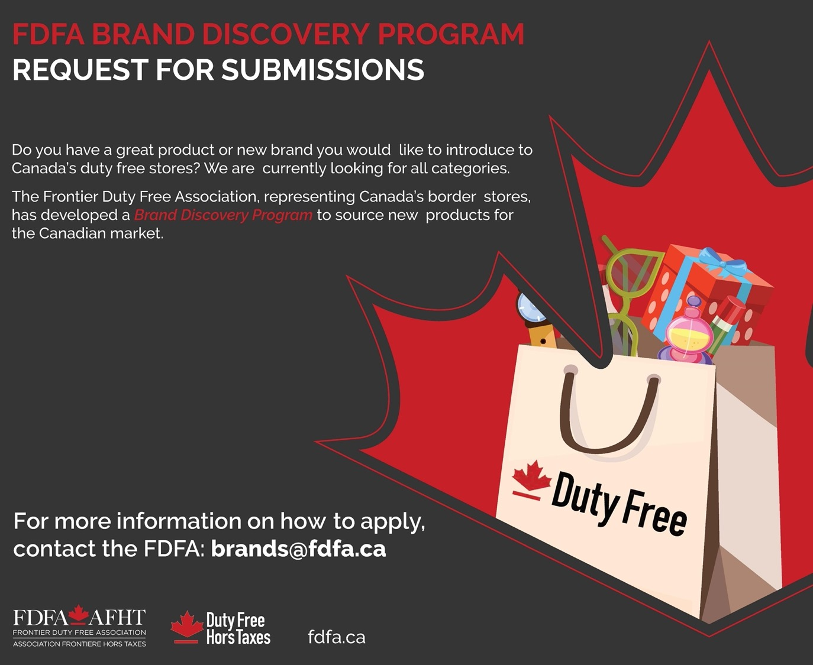
How can a new supplier introduce products?
In 2021, the FDFA launched a Brand Discovery Program to source new products globally.
Full details are available at brands@fdfa.ca

Slide 7

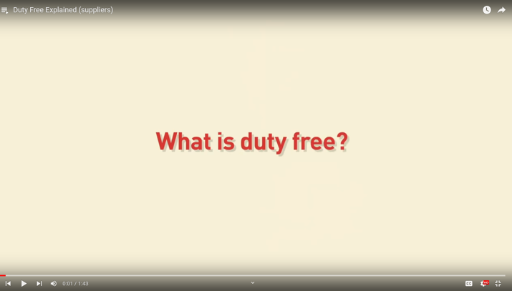

FAQ
Q What is the first step to have my products listed in a duty free store?
A To gauge level of interest in your products, contact the FDFA brands@fdfa.ca, or visit a store and ask to speak with the category buyer.
Q In what ways are the land border and airport stores different.
A Land border locations are small businesses, independently owned and operated by members of the local community. Airport stores are owned by larger international companies.
Q As a supplier what can I do to grow my brand in the Canadian duty free industry?
A If you brand is selling in three or more stores, consider joining the FDFA.
Duty Free Explained

Slide 8

Frontier Duty Free Association (FDFA)
The FDFA is industry representative to Canada’s land border duty free shops. Our mandate is to promote the development and success of border duty free sector, act as a voice, advocate and business resource for members.
Our Active Member category now includes 27 land border duty free shops. Our Associate membership category includes product and service suppliers, CDN airport duty free stores, and U.S. land border duty free stores.
FDFA activities:
  Member communications, events, and information services.
  Facilitates the Brand Discovery Program to source products globally.
  Government relations to address legal, regulatory and policy challenges and opportunities.
  Liaison between FDFA members and the federal Government’s Duty Free Shop Program staff.
  Media monitoring and public relations.
  Partnering with supplier, retail and tourism representatives to address challenges and opportunities.
  Management of two websites; a members’ only portal and a consumer site.

Slide 9

FDFA Membership
To qualify for membership, you must already be selling your products or services to Canada’s duty free shops.
Membership benefits:
  Contacts for member stores and their buyers/purchasing agents.
  Announcement introducing your company and products to the buyers.
  Access to the FDFA’s member’s only website and membership directory.
  Opportunity to attend FDFA events.
  Industry statistics.
  Partnering with the FDFA and stores to address business challenges and opportunities.

Slide 10

FDFA Convention
The FDFA trade convention is typically held in November.
This is the exclusive convention for qualifying FDFA members. It provides an opportunity for the buyers and suppliers to collaborate face to face. Canadian Airport Duty Free operators also attend.
Meetings are typically scheduled in advance and held in private meeting rooms.
Sponsorship opportunities are available to generate product awareness and promote brands.
Attendees: duty free shop owners, buyers, suppliers, media and industry stakeholders.

Slide 11



FDFA Contacts
Barbara Barrett, Executive Director
bbarrett@fdfa.ca
Allison Gardner, Manager of Operations
agardner@fdfa.ca
Brand Discovery Program
brands@fdfa.ca
Frontier Duty Free Association,
1404 - 222 Queen Street, Ottawa, Ontario K1P 5V9
Telephone: 613-688-9788
Canadadutyfree
FDFAInsider
Duty Free Canada
Frontier Duty Free Association

